Slide 1
Retail Store Transaction Analysis
Portfolio Project | Excel Dashboard & Data Insights
Johnson Daniel
Email: danieljohnsonk101@gmail.com

Slide 2
Project Overview
The objective of this project was to analyze retail transaction data to uncover sales trends, identify top performers, optimize payment systems and improve financial transparency using an Excel dashboard and data analysis technique.

Slide 3
Tool Used
Microsoft Excel(PivotTables, Slicer, Charts)
CONCAT for Ledger Key Creation
Data Cleaning and Transformation

Slide 4
Problem Statement & Business Objectives
Identify peak sales periods for better staffing and inventory.
Recognize top-performing cashiers and store managers.
Segment by payment type for optimized systems
Ensure robust financial tracking using ledger keys.

Slide 5
Key Questions
What are the peak sales during the time of the day?
Who are the top-performing cashiers and store managers?
Which payment methods are the most preferred?
How can ledger keys ensure transaction accuracy?

Slide 6
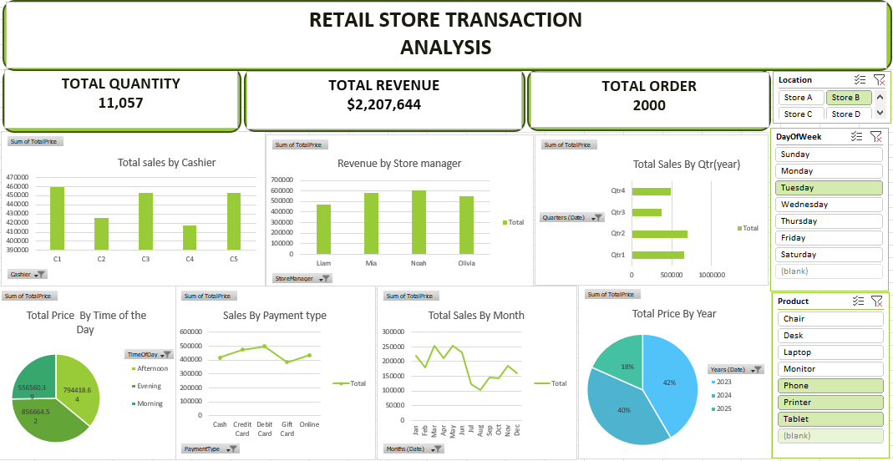
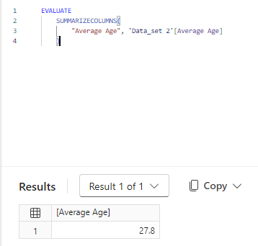
Dashboard Snapshot

Slide 7
Analysis & Insights
Sales Trend by Time
Evening : 39% (highest)
Afternoon: 36%
Morning: 25% (growth opportunity)
Top Performers
Cashier 1: $459k
Manager Noah: $608k

Slide 8
cont
Lowest Performers
Cashier 4: $417K
Manager Liam: $471
Payment Segmentation
Debit Cards: $498k(Dominant)
Credit Cards: $474k
Cash: $416k
Gift Cards: $382k(Lowest)

Slide 9
cont
Yearly, Monthly & Quarterly Trends
2023: 42% of the total sales(Best performing year)
May: $252K(Peak month)
Q2: $695K(Best quarter)
Q3: $370K(Lowest Quarter)

Slide 10
Recommendations
Boost Morning Sales: Offer early bird discount and office hour promo.
Reward Top performers: Incentives for top cashier and managers to maintain motivation.
Optimize Payment: Improve POS and digital systems for debit/credit users.
Plan for Q4 Growth: Early holiday campaigns can maximize revenue

Slide 11
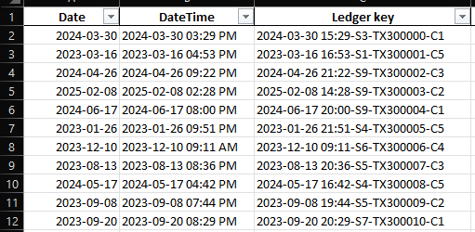
Ledger Key System

